Slide 1

Key Management and Distribution
Notes:
The topics of cryptographic key management and cryptographic key distribution are
complex, involving cryptographic, protocol, and management considerations. The purpose
of this chapter is to give the reader a feel for the issues involved and a broad survey
of the various aspects of key management and distribution. For more information,
the place to start is the three-volume NIST SP 800-57, followed by the recommended
readings listed at the end of this chapter.

Slide 2


Cryptography and Network Security
REFERENCE
Chapters 8,14
Seventh Edition, Global Edition
by William Stallings
Notes:
Lecture slides prepared for “Cryptography and Network Security”, 7/e, by William Stallings, Chapter 14 – “Key Management and Distribution”.

Slide 3
Key Generation
True random number generators
Entropy sources
Comparison of PRNGs and TRNGs
Conditioning
Health Testing
Intel digital random number generator

Slide 4
Randomness Tests
Three tests
Frequency test
The most basic test and must be included in any test suite
Purpose is to determine whether the number of ones and zeros in a sequence is approximately the same as would be expected for a truly random sequence
Runs test
Focus of this test is the total number of runs in the sequence, where a run is an uninterrupted sequence of identical bits bounded before and after with a bit of the opposite value
Purpose is to determine whether the number of runs of ones and zeros of various lengths is as expected for a random sequence
Maurer’s universal statistical test
Focus is the number of bits between matching patterns
Purpose is to detect whether or not the sequence can be significantly compressed without loss of information. A significantly compressible sequence is considered to be non-random
NIST SP 800-22
Notes:
NIST SP 800-22 lists 15 separate tests of randomness. An understanding of these
tests requires a basic knowledge of statistical analysis, so we don’t attempt a
technical description here. Instead, to give some flavor for the tests, we list three of
the tests and the purpose of each test, as follows.
• Frequency test: This is the most basic test and must be included in any test
suite. The purpose of this test is to determine whether the number of ones and
zeros in a sequence is approximately the same as would be expected for a truly
random sequence.
• Runs test: The focus of this test is the total number of runs in the sequence,
where a run is an uninterrupted sequence of identical bits bounded before
and after with a bit of the opposite value. The purpose of the runs test is to
determine whether the number of runs of ones and zeros of various lengths is
as expected for a random sequence.
• Maurer’s universal statistical test: The focus of this test is the number of bits
between matching patterns (a measure that is related to the length of a compressed
sequence). The purpose of the test is to detect whether or not the
sequence can be significantly compressed without loss of information. A significantly
compressible sequence is considered to be non-random.

Slide 5
Entropy Sources
A true random number generator (TRNG) uses a nondeterministic source to produce randomness
Most operate by measuring unpredictable natural processes such as pulse detectors of ionizing radiation events, gas discharge tubes, and leaky capacitors
Intel has developed a commercially available chip that samples thermal noise by amplifying the voltage measured across undriven resistors
LavaRnd is an open source project for creating truly random numbers using inexpensive cameras, open source code, and inexpensive hardware
The system uses a saturated CCD in a light-tight can as a chaotic source to produce the seed; software processes the result into truly random numbers in a variety of formats
Notes:
A true random number generator (TRNG) uses a nondeterministic source to
produce randomness. Most operate by measuring unpredictable natural processes,
such as pulse detectors of ionizing radiation events, gas discharge tubes,
and leaky capacitors. Intel has developed a commercially available chip that samples
thermal noise by amplifying the voltage measured across undriven resistors
[JUN99]. LavaRnd is an open source project for creating truly random numbers
using inexpensive cameras, open source code, and inexpensive hardware. The
system uses a saturated CCD in a light-tight can as a chaotic source to produce
the seed. Software processes the result into truly random numbers in a variety of
formats.

Slide 6
Possible Sources of Randomness
RFC 4086 lists the following possible sources of randomness that can be used on a computer to generate true random sequences:
Sound/video input
The input from a sound digitizer with no source plugged in or from a camera with the lens cap on is essentially thermal noise
If the system has enough gain to detect anything, such input can provide reasonable high quality random bits
Disk drives
Have small random fluctuations in their rotational speed due to chaotic air turbulence
The addition of low-level disk seek-time instrumentation produces a series of measurements that contain this randomness
There is also an online service (random.org) which can deliver random sequences securely over the Internet
Notes:
RFC 4086 lists the following possible sources of randomness that, with care,
easily can be used on a computer to generate true random sequences.
• Sound/video input: Many computers are built with inputs that digitize some
real-world analog source, such as sound from a microphone or video input
from a camera. The “input” from a sound digitizer with no source plugged
in or from a camera with the lens cap on is essentially thermal noise. If the
system has enough gain to detect anything, such input can provide reasonably
high quality random bits.
• Disk drives: Disk drives have small random fluctuations in their rotational
speed due to chaotic air turbulence [JAKO98]. The addition of low-level disk
seek-time instrumentation produces a series of measurements that contain
this randomness. Such data is usually highly correlated, so significant processing
is needed. Nevertheless, experimentation a decade ago showed that, with
such processing, even slow disk drives on the slower computers of that day
could easily produce 100 bits a minute or more of excellent random data.
There is also an online service (random.org), which can deliver random
sequences securely over the Internet.

Slide 7
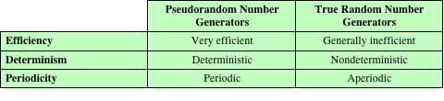
Table 8.5
Comparison of PRNGs and TRNGs
Notes:
Table 8.5 summarizes the principal differences between PRNGs and TRNGs.
PRNGs are efficient, meaning they can produce many numbers in a short time, and
deterministic, meaning that a given sequence of numbers can be reproduced at a
later date if the starting point in the sequence is known. Efficiency is a nice characteristic
if your application needs many numbers, and determinism is handy if you
need to replay the same sequence of numbers again at a later stage. PRNGs are
typically also periodic, which means that the sequence will eventually repeat itself.
While periodicity is hardly ever a desirable characteristic, modern PRNGs have a
period that is so long that it can be ignored for most practical purposes.
TRNGs are generally rather inefficient compared to PRNGs, taking considerably
longer time to produce numbers. This presents a difficulty in many applications.
For example, cryptography system in banking or national security might need
to generate millions of random bits per second. TRNGs are also nondeterministic,
meaning that a given sequence of numbers cannot be reproduced, although the same
sequence may of course occur several times by chance. TRNGs have no period.

Slide 8
Conditioning
A TRNG may produce an output that is biased in some way (such as having more ones than zeros or vice versa)
Biased
NIST SP 800-90B defines a random process as biased with respect to an assumed discrete set of potential outcomes if some of those outcomes have a greater probability of occurring than do others
Entropy rate
NIST 800-90B defines entropy rate as the rate at which a digitized noise source provides entropy
Is a measure of the randomness or unpredictability of a bit string
Will be a value between 0 (no entropy) and 1 (full entropy)
Conditioning algorithms/deskewing algorithms
Methods of modifying a bit stream to further randomize the bits
Typically conditioning is done by using a cryptographic algorithm to scramble the random bits so as to eliminate bias and increase entropy
The two most common approaches are the use of a hash function or a symmetric block cipher
Notes:
A TRNG may produce an output that is biased in some way, such as having more
ones than zeros or vice versa. More generally, NIST SP 800-90B defines a random
process as biased with respect to an assumed discrete set of potential outcomes
(i.e., possible output values) if some of those outcomes have a greater probability
of occurring than do others. For example, a physical source such as electronic noise
may contain a superposition of regular structures, such as waves or other periodic
phenomena, which may appear to be random, yet are determined to be non-random
using statistical tests.
In addition to bias, another concept used by SP 800-98B is that of entropy rate .
SP 800-90B defines entropy rate as the rate at which a digitized noise source (or
entropy source) provides entropy; it is computed as the assessed amount of entropy
provided by a bit string output from the source, divided by the total number of
bits in the bit string (yielding assessed bits of entropy per output bit). This will be
a value between 0 (no entropy) and 1 (full entropy). Entropy rate is a measure
of the randomness or unpredictability of a bit string. Another way of expressing
it is that the entropy rate is k /n for a random source of length n bits and min-entropy
k . Min-entropy is a measure of the number of random bits and is explained
in Appendix F. In essence, a block of bits or a bit stream that is unbiased, and in
which each bit and each group of bits is independent of all other bits and groups of
bits will have an entropy rate of 1.
For hardware sources of random bits, the recommended approach is to assume
that there may be bias and/or an entropy rate of less than 1 and to apply techniques
to further “randomize” the bits. Various methods of modifying a bit stream for this
purpose have been developed. These are referred to as conditioning algorithms or
deskewing algorithms .
Typically, conditioning is done by using a cryptographic algorithm to “scramble”
the random bits so as to eliminate bias and increase entropy. The two most common
approaches are the use of a hash function or a symmetric block cipher.

Slide 9
Hash Function
A hash function produces an n-bit output from an input of arbitrary length
A simple way to use a hash function for conditioning is as follows:
Blocks of m input bits, with m ≥ n, are passed through the hash function and the n output bits are used as random bits
To generate a stream of random bits, successive input blocks pass through the hash function to produce successive hashed output blocks
Notes:
A hash function produces an n -bit output
from an input of arbitrary length. A simple way to use a hash function for conditioning
is as follows. Blocks of m input bits, with m Ú n , are passed through the
hash function and the n output bits are used as random bits. To generate a stream
of random bits, successive input blocks pass through the hash function to produce
successive hashed output blocks.
Operating systems typically provide a built-in mechanism for generating random
numbers. For example, Linux uses four entropy sources: mouse and keyboard
activity, disk I/O operations, and specific interrupts. Bits are generated from these
four sources and combined in a pooled buffer. When random bits are needed, the
appropriate number of bits are read from the buffer and passed through the SHA-1
hash function [GUTT06].
A more complex approach is the hash derivation function specified in
SP800-90A. Hash_df can be defined as follows:
Parameters:
input_string : The string to be hashed.
outlen : Output length.
no_of_bits_to_return : The number of bits to be returned by Hash_df. The maximum
length (max_number_of_bits ) is implementation dependent, but shall be
less than or equal to (255 * outlen ). no_of_bits_to_return is represented as a
32-bit integer.
requested_bits : The result of performing the Hash_df.

Slide 10
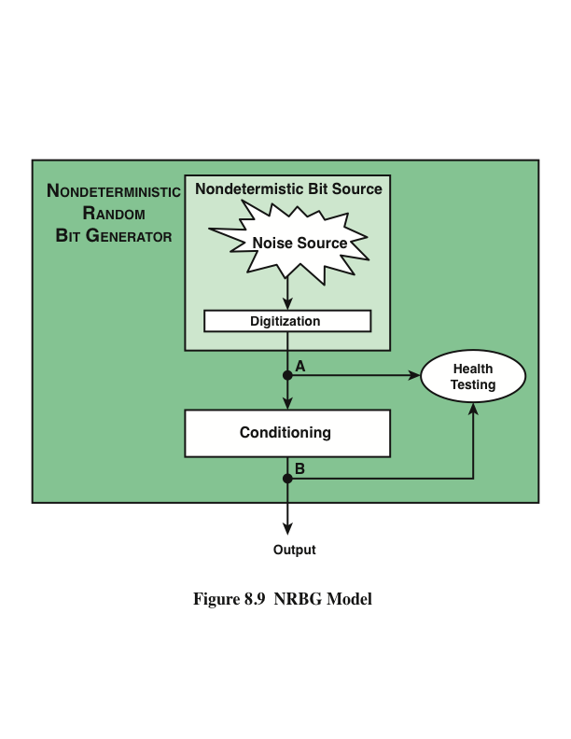
Notes:
Figure 8.9 provides a general model for a nondeterministic random bit generator.
A hardware noise source produces a true random output. This is digitized to produce
true, or nondeterministic, source of bits. This bit source then passes through a
conditioning module to mitigate bias and maximize entropy.
Figure 8.9 also shows a health-testing module, which is used on the outputs
of both the digitizer and conditioner. In essence, health testing is used to validate
that the noise source is working as expected and that the conditioning module is
produced output with the desired characteristics. Both forms of health testing are
recommended by SP 800-90B.

Slide 11
Health Tests on the Noise Source
The nature of the health testing of the noise source depends strongly on the technology used to produce noise
In general, the assumption can be made that the digitized output of the noise source will exhibit some bias
Thus, traditional statistical tests are not useful for monitoring the noise source, because the noise source is likely to always fail
The tests on the noise source need to be tailored to the expected statistical behavior of the correctly operating noise source
The goal is not to determine if the source is unbiased, but if it is operating as expected
Notes:
The nature of the health testing of the noise
source depends strongly on the technology used to produce noise. In general, we
can assume that the digitized output of the noise source will exhibit some bias. Thus,
the traditional statistical tests, such as those defined in SP 800-22 and discussed in
Section 8.1, are not useful for monitoring the noise source, because the noise source
is likely to always fail. Rather, the tests on the noise source need to be tailored to
the expected statistical behavior of the correctly operating noise source. The goal
is not to determine if the source is unbiased, which it isn’t, but if it is operating
as expected.
SP 800-90B specifies that continuous tests be done on digitized samples
obtained from the noise source (point A in Figure 8.9). The purpose is to test for
variability. More specifically, the purpose is to determine if the noise source is producing
at the expected entropy rate. SP 800-909B mandates the use of two tests: the
Repetition Count Test and the Adaptive Proportion Test.
The Repetition Count Test is designed to quickly detect a catastrophic failure
that causes the noise source to become “stuck” on a single output value for a long
time. For this test, it is assumed that a given noise source is assessed to have a given
min-entropy value of H . The entropy is expressed as the amount of entropy
per sample, where a sample could be a single bit or some block of bits of length n . With an
assessed value of H , it is straightforward to calculate the probability that a sequence
of C consecutive samples will yield identical sample values.
The Repetition Count Test starts by recording a sample value and then counting
the number of repetitions of the same value. If the counter reaches the cutoff
value C, an error is reported. If a sample value is encountered that differs from the
preceding sample, then the counter is reset to 1 and the algorithm starts over.
The Adaptive Proportion Test is designed to detect a large loss of entropy,
such as might occur as a result of some physical failure or environmental change
affecting the noise source. The test continuously measures the local frequency of
occurrence of some sample value in a sequence of noise source samples to determine
if the sample occurs too frequently

Slide 12
Health Tests on the Noise Source
SP 800-90B specifies that continuous tests be done on digitized samples obtained from the noise source
The purpose is to test for variability and to determine if the noise source is producing at the expected entropy rate
SP 800-90B mandates the use of two tests
Repetition Count Test
Designed to quickly detect a catastrophic failure that causes the noise source to become “stuck” on a single output value for a long time
Involves looking for consecutive identical samples
Adaptive Proportion Test
Designed to detect a large loss of entropy, such as might occur as a result of some physical failure or environmental change affecting the noise source
The test continuously measures the local frequency of occurrence of some sample value in a sequence of noise source samples to determine if the sample occurs too frequently
Notes:
SP 800-90B specifies that continuous tests be done on digitized samples
obtained from the noise source (point A in Figure 8.9). The purpose is to test for
variability. More specifically, the purpose is to determine if the noise source is producing
at the expected entropy rate. SP 800-909B mandates the use of two tests: the
Repetition Count Test and the Adaptive Proportion Test.
The Repetition Count Test is designed to quickly detect a catastrophic failure
that causes the noise source to become “stuck” on a single output value for a long
time. For this test, it is assumed that a given noise source is assessed to have a given
min-entropy value of H . The entropy is expressed as the amount of entropy
per sample, where a sample could be a single bit or some block of bits of length n . With an
assessed value of H , it is straightforward to calculate the probability that a sequence
of C consecutive samples will yield identical sample values.
The Repetition Count Test starts by recording a sample value and then counting
the number of repetitions of the same value. If the counter reaches the cutoff
value C, an error is reported. If a sample value is encountered that differs from the
preceding sample, then the counter is reset to 1 and the algorithm starts over.
The Adaptive Proportion Test is designed to detect a large loss of entropy,
such as might occur as a result of some physical failure or environmental change
affecting the noise source. The test continuously measures the local frequency of
occurrence of some sample value in a sequence of noise source samples to determine
if the sample occurs too frequently

Slide 13
Health Tests on the Conditioning Function
SP 800-90B specifies that health tests should also be applied to the output of the conditioning component, but does not indicate which tests to use
The purpose of the health tests on the conditioning component is to assure that the output behaves as a true random bit stream
It is reasonable to use the tests for randomness defined in SP 800-22
Notes:
SP 800-90B specifies that health tests should also be applied to the output of the conditioning component (point B in Figure 8.9), but does not indicate which tests to use. The purpose of the health
tests on the conditioning component is to assure that the output behaves as a true
random bit stream. Thus, it is reasonable to use the tests for randomness defined in
SP 800-22, and described in Section 8.1.

Slide 14
Intel Digital Random Number Generator
TRNGs have traditionally been used only for key generation and other applications where only a small number of random bits were required
This is because TRNGs have generally been inefficient with a low bit rate of random bit production
The first commercially available TRNG that achieves bit production rates comparable with that of PRNGs is the Intel digital random number generator offered on new multicore chips since May 2012
It is implemented entirely in hardware
The entire DRNG is on the same multicore chip as the processors
Notes:
As was mentioned, TRNGs have traditionally been used only for key generation
and other applications where only a small number of random bits were required.
This is because TRNGs have generally been inefficient, with a low bit rate of random
bit production.
The first commercially available TRNG that achieves bit production rates
comparable with that of PRNGs is the Intel digital random number generator
(DRNG) [TAYL11], offered on new multicore chips since May 2012.
Two notable aspects of the DRNG:
1. It is implemented entirely in hardware. This provides greater security than a facility
that includes a software component. A hardware-only implementation should
also be able to achieve greater computation speed than a software module.
2. The entire DRNG is on the same multicore chip as the processors. This eliminates
the I/O delays found in other hardware random number generators.

Slide 15
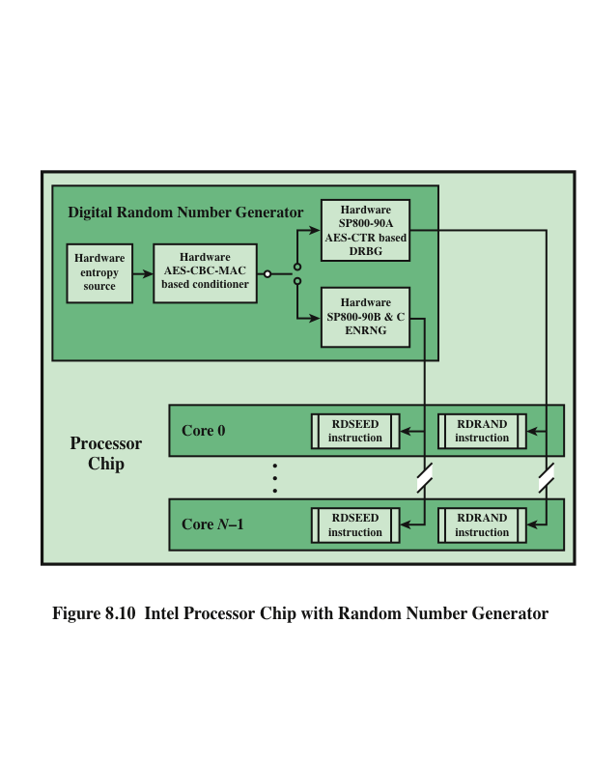
Notes:
Figure 8.10 shows the overall structure of the DRNG. The first stage of the DRNG
generates random numbers from thermal noise. The heart of the stage consists of
two inverters (NOT gates), with the output of each inverter connected to the input
of the other. Such an arrangement has two stable states, with one inverter having an
output of logical 1 and the other having an output of logical 0. The circuit is then configured
so that both inverters are forced to have the same indeterminate state (both
inputs and both outputs at logical 1) by clock pulses. Random thermal noise within
the inverters soon jostles the two inverters into a mutually stable state. Additional
circuitry is intended to compensate for any biases or correlations. This stage is
capable, with current hardware, of generating random bits at a rate of 4 Gbps.
The output of the first stage is generated 512 bits at a time. To assure that
the bit stream does not have skew or bias, a second stage of processing randomizes
its input using a cryptographic function. In this case, the function is referred to
as CBC-MAC or CMAC, as specified in NIST SP 800-38B. In essence, CMAC
encrypts its input using the cipher block chaining (CBC) mode (Figure 6.4) and
outputs the final block. We examine CMAC in detail in Chapter 12. The output of
this stage is generated 256 bits at a time and is intended to exhibit true randomness
with no skew or bias.
While the hardware’s circuitry generates random numbers from thermal noise
much more quickly than its predecessors, it’s still not fast enough for some of today’s
computing requirements. To enable the DRNG to generate random numbers
as quickly as software PRNG, and also maintain the high quality of the random numbers,
a third stage is added. This stage uses the 256-bit random numbers to seed
a cryptographically secure PRNG that creates 128-bit numbers. From one 256-bit
seed, the PRNG can output many pseudorandom numbers, exceeding the 3-Gbps
rate of the entropy source. An upper bound of 511 128-bit samples can be generated
per seed. The algorithm used for this stage is CTR_DRBG, described in Section 8.3.
The output of the DRNG is available to each of the cores on the chip via the
RDRAND instruction. RDRAND retrieves a 16-, 32-, or 64-bit random value and
makes it available in a software-accessible register.
Preliminary data from a pre-production sample on a system with a third
generation Intel® Core™ family processor produced the following performance
[INTE12]: up to 70 million RDRAND invocations per second, and a random data
production rate of over 4 Gbps.

Slide 16
Key Distribution

Slide 17
Key Distribution Technique
Term that refers to the means of delivering a key to two parties who wish to exchange data without allowing others to see the key
For symmetric encryption to work, the two parties to an exchange must share the same key, and that key must be protected from access by others
Frequent key changes are desirable to limit the amount of data compromised if an attacker learns the key
Notes:
For symmetric encryption to work, the two parties to an exchange must share the
same key, and that key must be protected from access by others. Furthermore, frequent
key changes are usually desirable to limit the amount of data compromised if
an attacker learns the key. Therefore, the strength of any cryptographic system rests
with the key distribution technique , a term that refers to the means of delivering a
key to two parties who wish to exchange data without allowing others to see the key.

Slide 18
Symmetric Key Distribution
Given parties A and B, key distribution can be achieved in a number of ways:
A can select a key and physically deliver it to B
A third party can select the key and physically deliver it to A and B
If A and B have previously and recently used a key, one party can transmit the new key to the other, encrypted using the old key
If A and B each has an encrypted connection to a third party C, C can deliver a key on the encrypted links to A and B
Notes:
For two parties A and B, key distribution can be achieved in a number of ways, as
follows:
1. A can select a key and physically deliver it to B.
2. A third party can select the key and physically deliver it to A and B.
3. If A and B have previously and recently used a key, one party can transmit the
new key to the other, encrypted using the old key.
4. If A and B each has an encrypted connection to a third party C, C can deliver
a key on the encrypted links to A and B.
Options 1 and 2 call for manual delivery of a key. For link encryption, this
is a reasonable requirement, because each link encryption device is going to be
exchanging data only with its partner on the other end of the link. However, for
end-to-end encryption over a network, manual delivery is awkward. In a distributed
system, any given host or terminal may need to engage in exchanges with
many other hosts and terminals over time. Thus, each device needs a number of
keys supplied dynamically. The problem is especially difficult in a wide-area distributed
system.

Slide 19
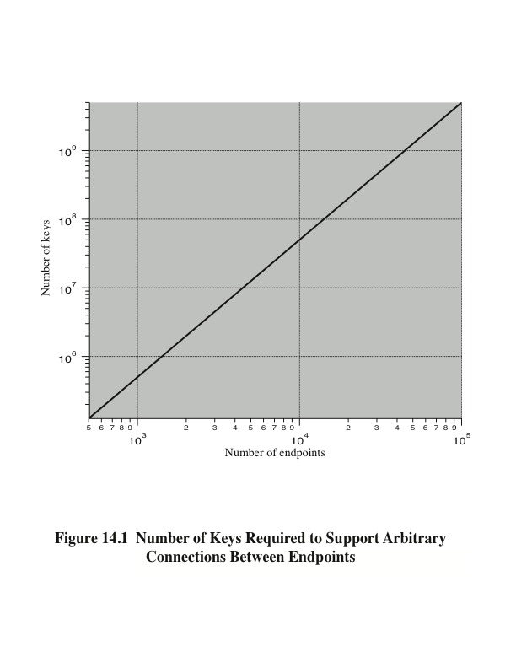
Notes:
The scale of the problem depends on the number of communicating pairs that must be supported. If end-to-end encryption is done at a network or IP level, then a key is needed for each pair of hosts on the network that wish to communicate. Thus, if there are N hosts, the number of required keys is [N(N – 1)]/2. If encryption is done at the application level, then a key is needed for every pair of users or processes that require communication. Thus, a network may have hundreds of hosts but thousands of users and processes. Figure 14.1 illustrates the magnitude of the key distribution task for end-to-end encryption. A network using node-level encryption with 1000 nodes would conceivably need to distribute as many as half a million keys. If that same network supported 10,000 applications, then as many as 50 million keys may be required for application-level encryption.

Slide 20

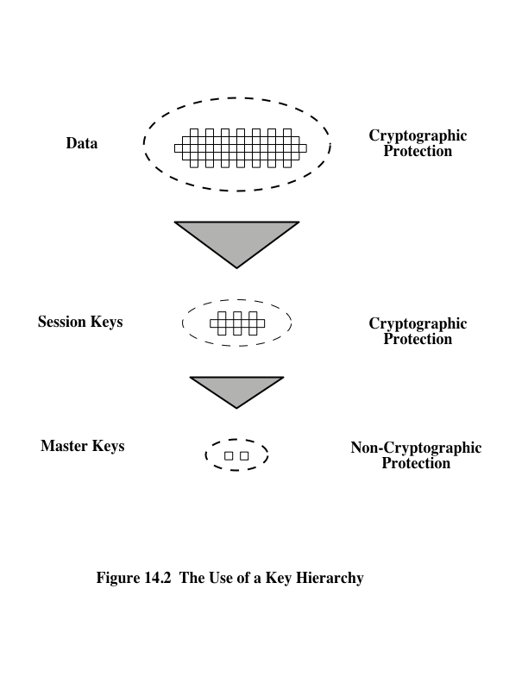
Notes:
For end-to-end encryption, some variation on option 4 has been widely
adopted. In this scheme, a key distribution center is responsible for distributing
keys to pairs of users (hosts, processes, applications) as needed. Each user must
share a unique key with the key distribution center for purposes of key distribution.
The use of a key distribution center is based on the use of a hierarchy of keys.
At a minimum, two levels of keys are used (Figure 14.2). Communication between
end systems is encrypted using a temporary key, often referred to as a session key .
Typically, the session key is used for the duration of a logical connection, such as a
frame relay connection or transport connection, and then discarded. Each session
key is obtained from the key distribution center over the same networking facilities
used for end-user communication. Accordingly, session keys are transmitted in
encrypted form, using a master key that is shared by the key distribution center and
an end system or user.
For each end system or user, there is a unique master key that it shares with
the key distribution center. Of course, these master keys must be distributed in some
fashion. However, the scale of the problem is vastly reduced. If there are N entities
that wish to communicate in pairs, then, as was mentioned, as many as [N (N - 1)]/2
session keys are needed at any one time. However, only N master keys are required,
one for each entity. Thus, master keys can be distributed in some non-cryptographic
way, such as physical delivery.

Slide 21
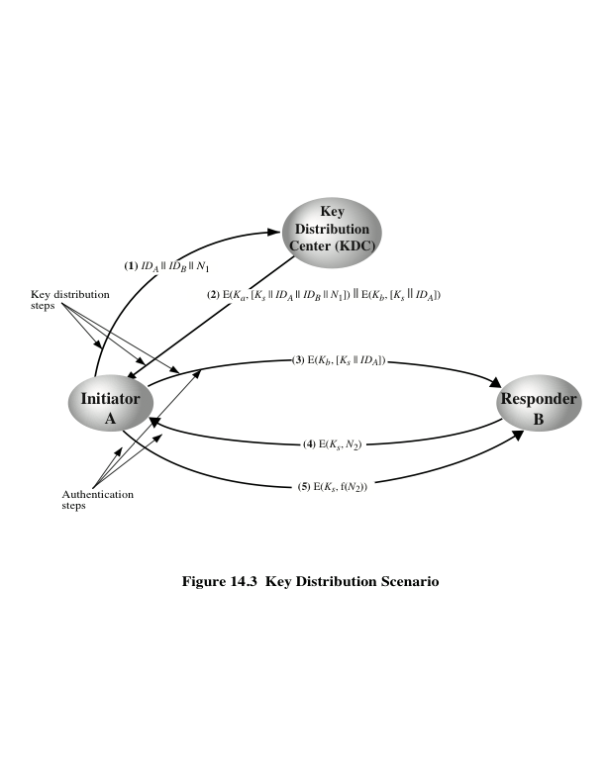
Notes:
The key distribution concept can be deployed in a number of ways. A typical
scenario is illustrated in Figure 14.3, which is based on a figure in [POPE79]. The
scenario assumes that each user shares a unique master key with the key distribution
center (KDC).

Slide 22
Hierarchical Key Control
For communication among entities within the same local domain, the local KDC is responsible for key distribution
If two entities in different domains desire a shared key, then the corresponding local KDC’s can communicate through a global KDC
The hierarchical concept can be extended to three or more layers
Scheme minimizes the effort involved in master key distribution because most master keys are those shared by a local KDC with its local entities
Limits the range of a faulty or subverted KDC to its local area only
Notes:
It is not necessary to limit the key distribution function to a single KDC. Indeed, for
very large networks, it may not be practical to do so. As an alternative, a hierarchy
of KDCs can be established. For example, there can be local KDCs, each responsible
for a small domain of the overall internetwork, such as a single LAN or a single
building. For communication among entities within the same local domain, the local
KDC is responsible for key distribution. If two entities in different domains desire a
shared key, then the corresponding local KDCs can communicate through a global
KDC. In this case, any one of the three KDCs involved can actually select the key.
The hierarchical concept can be extended to three or even more layers, depending
on the size of the user population and the geographic scope of the internetwork.
A hierarchical scheme minimizes the effort involved in master key distribution,
because most master keys are those shared by a local KDC with its local entities.
Furthermore, such a scheme limits the damage of a faulty or subverted KDC to
its local area only.

Slide 23
Session Key Lifetime
A security manager must balance competing considerations:
The more frequently session keys are exchanged, the more secure they are
The distribution of session keys delays the start of any exchange and places a burden on network capacity
For connection-oriented protocols one choice is to use the same session key for the length of time that the connection is open, using a new session key for each new session
For a connectionless protocol there is no explicit connection initiation or termination, thus it is not obvious how often one needs to change the session key
Notes:
The more frequently session keys are exchanged, the more secure they are, because
the opponent has less ciphertext to work with for any given session key. On the
other hand, the distribution of session keys delays the start of any exchange and
places a burden on network capacity. A security manager must try to balance these
competing considerations in determining the lifetime of a particular session key.
For connection-oriented protocols, one obvious choice is to use the same session
key for the length of time that the connection is open, using a new session key
for each new session. If a logical connection has a very long lifetime, then it would
be prudent to change the session key periodically, perhaps every time the PDU
(protocol data unit) sequence number cycles.
For a connectionless protocol, such as a transaction-oriented protocol, there
is no explicit connection initiation or termination. Thus, it is not obvious how often
one needs to change the session key. The most secure approach is to use a new session
key for each exchange. However, this negates one of the principal benefits of
connectionless protocols, which is minimum overhead and delay for each transaction.
A better strategy is to use a given session key for a certain fixed period only or
for a certain number of transactions.

Slide 24
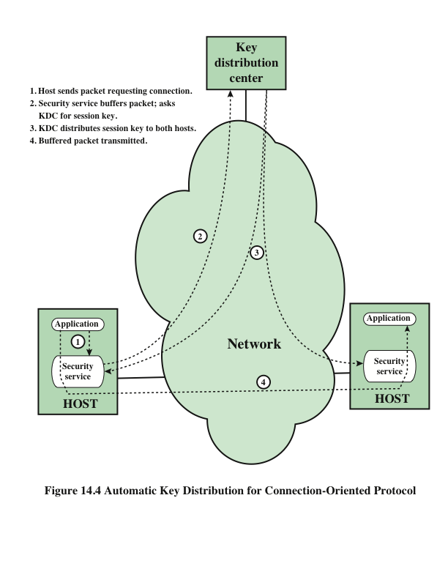
Notes:
The approach suggested in Figure 14.3 has many variations, one of which is
described in this subsection. The scheme (Figure 14.4) is useful for providing end-to-
end encryption at a network or transport level in a way that is transparent to
the end users. The approach assumes that communication makes use of a connection-
oriented end-to-end protocol, such as TCP. The noteworthy element of this
approach is a session security module (SSM), which may consist of functionality at
one protocol layer, that performs end-to-end encryption and obtains session keys
on behalf of its host or terminal.
The steps involved in establishing a connection are shown in Figure 14.4. When
one host wishes to set up a connection to another host, it transmits a connection-request
packet (step 1). The SSM saves that packet and applies to the KDC for permission
to establish the connection (step 2). The communication between the SSM and
the KDC is encrypted using a master key shared only by this SSM and the KDC. If the
KDC approves the connection request, it generates the session key and delivers it to
the two appropriate SSMs, using a unique permanent key for each SSM (step 3). The
requesting SSM can now release the connection request packet, and a connection is
set up between the two end systems (step 4). All user data exchanged between the two
end systems are encrypted by their respective SSMs using the one-time session key.
The automated key distribution approach provides the flexibility and dynamic
characteristics needed to allow a number of terminal users to access a number of
hosts and for the hosts to exchange data with each other.

Slide 25
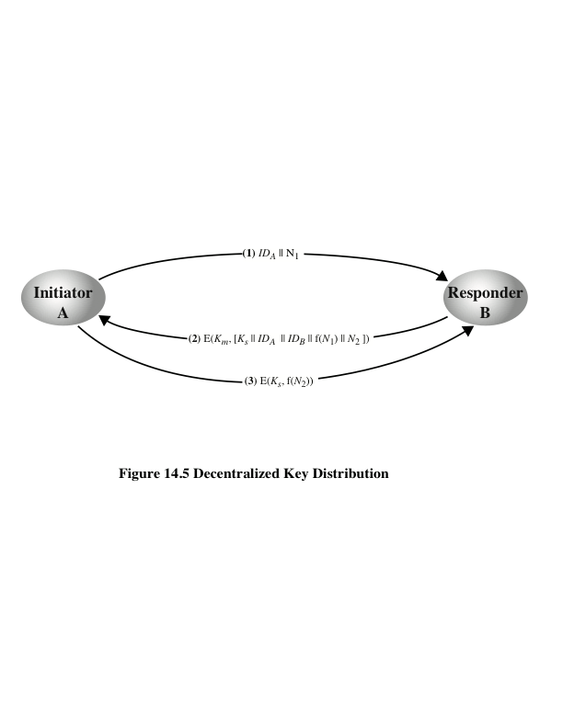
Notes:
The use of a key distribution center imposes the requirement that the KDC be trusted
and be protected from subversion. This requirement can be avoided if key distribution
is fully decentralized. Although full decentralization is not practical for larger
networks using symmetric encryption only, it may be useful within a local context.
A decentralized approach requires that each end system be able to communicate
in a secure manner with all potential partner end systems for purposes of
session key distribution. Thus, there may need to be as many as [n (n - 1)]/2 master
keys for a configuration with n end systems.
A session key may be established with the following sequence of steps
(Figure 14.5).
1. A issues a request to B for a session key and includes a nonce, N₁.
2. B responds with a message that is encrypted using the shared master key. The
response includes the session key selected by B, an identifier of B, the value
f(N₁), and another nonce, N₂.
3. Using the new session key, A returns f(N₂) to B.
Thus, although each node must maintain at most (n - 1) master keys, as many
session keys as required may be generated and used. Because the messages transferred
using the master key are short, cryptanalysis is difficult. As before, session
keys are used for only a limited time to protect them.

Slide 26
Controlling Key Usage
The concept of a key hierarchy and the use of automated key distribution techniques greatly reduce the number of keys that must be manually managed and distributed
It also may be desirable to impose some control on the way in which automatically distributed keys are used
For example, in addition to separating master keys from session keys, we may wish to define different types of session keys on the basis of use
Notes:
The concept of a key hierarchy and the use of automated key distribution techniques
greatly reduce the number of keys that must be manually managed and distributed.
It also may be desirable to impose some control on the way in which automatically
distributed keys are used. For example, in addition to separating master keys from
session keys, we may wish to define different types of session keys on the basis of
use, such as
• Data-encrypting key, for general communication across a network
• PIN-encrypting key, for personal identification numbers (PINs) used in electronic
funds transfer and point-of-sale applications
• File-encrypting key, for encrypting files stored in publicly accessible locations
To illustrate the value of separating keys by type, consider the risk that a master
key is imported as a data-encrypting key into a device. Normally, the master key
is physically secured within the cryptographic hardware of the key distribution center
and of the end systems. Session keys encrypted with this master key are available
to application programs, as are the data encrypted with such session keys. However,
if a master key is treated as a session key, it may be possible for an unauthorized
application to obtain plaintext of session keys encrypted with that master key.

Slide 27
Key Controls
Associate a tag with each key
For use with DES and makes use of the extra 8 bits in each 64-bit DES key
The eight non-key bits ordinarily reserved for parity checking form the key tag
Because the tag is embedded in the key, it is encrypted along with the key when that key is distributed, thus providing protection
Drawbacks:
The tag length is limited to 8 bits, limiting its flexibility and functionality
Because the tag is not transmitted in clear form, it can be used only at the point of decryption, limiting the ways in which key use can be controlled
Notes:
Thus, it may be desirable to institute controls in systems that limit the ways
in which keys are used, based on characteristics associated with those keys. One
simple plan is to associate a tag with each key ([JONE82]; see also [DAVI89]). The
proposed technique is for use with DES and makes use of the extra 8 bits in each
64-bit DES key. That is, the eight non-key bits ordinarily reserved for parity checking
form the key tag. The bits have the following interpretation:
• One bit indicates whether the key is a session key or a master key.
• One bit indicates whether the key can be used for encryption.
• One bit indicates whether the key can be used for decryption.
• The remaining bits are spares for future use.
Because the tag is embedded in the key, it is encrypted along with the key when that
key is distributed, thus providing protection. The drawbacks of this scheme are
1. The tag length is limited to 8 bits, limiting its flexibility and functionality.
2. Because the tag is not transmitted in clear form, it can be used only at the
point of decryption, limiting the ways in which key use can be controlled.

Slide 28
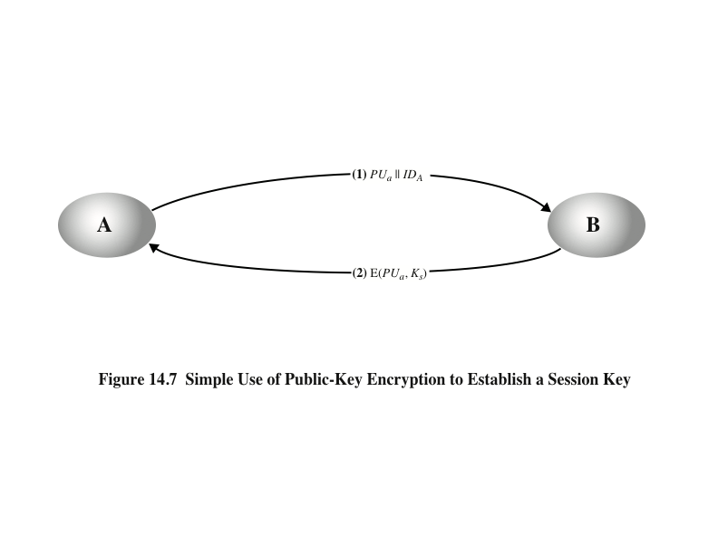
Notes:
An extremely simple scheme was put forward by Merkle [MERK79], as illustrated in
Figure 14.7.
Despite its simplicity, this is an attractive protocol. No keys exist before the start of
the communication and none exist after the completion of communication. Thus,
the risk of compromise of the keys is minimal. At the same time, the communication
is secure from eavesdropping.

Slide 29
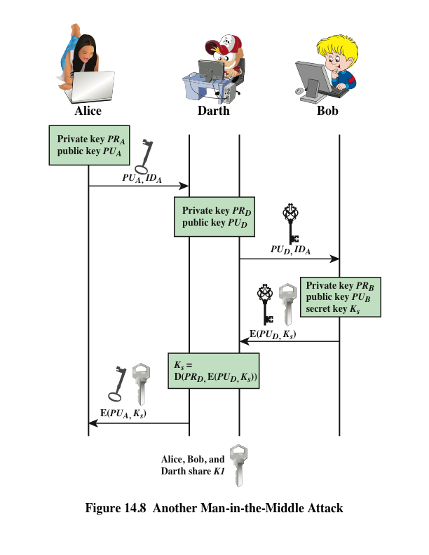
Notes:
The protocol depicted in Figure 14.7 is insecure against an adversary who
can intercept messages and then either relay the intercepted message or substitute
another message (see Figure 1.3c). Such an attack is known as a man-in-the-middle
attack [RIVE84]. We saw this type of attack in Chapter 10 (Figure 10.2). In the
present case, if an adversary, D, has control of the intervening communication channel,
then D can compromise the communication in the following fashion without
being detected (Figure 14.8).
Thus, this simple protocol is only useful in an environment where the only threat is eavesdropping.

Slide 30
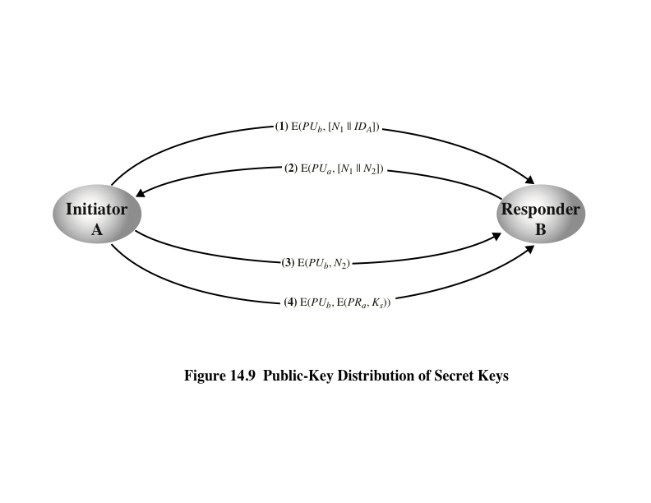
Notes:
Figure 14.9, based on an approach suggested in [NEED78], provides protection
against both active and passive attacks.
The result is that this scheme ensures both confidentiality and authentication
in the exchange of a secret key.

Slide 31
A Hybrid Scheme
In use on IBM mainframes
Retains the use of a key distribution center (KDC) that shares a secret master key with each user and distributes secret session keys encrypted with the master key
A public-key scheme is used to distribute the master keys
Rationale:
Performance
Backward compatibility
Notes:
Yet another way to use public-key encryption to distribute secret keys is a hybrid
approach in use on IBM mainframes [LE93]. This scheme retains the use of a key
distribution center (KDC) that shares a secret master key with each user and distributes
secret session keys encrypted with the master key. A public-key scheme is
used to distribute the master keys. The following rationale is provided for using this
three-level approach:
• Performance: There are many applications, especially transaction-oriented
applications, in which the session keys change frequently. Distribution of session
keys by public-key encryption could degrade overall system performance
because of the relatively high computational load of public-key encryption
and decryption. With a three-level hierarchy, public-key encryption is used
only occasionally to update the master key between a user and the KDC.
• Backward compatibility: The hybrid scheme is easily overlaid on an existing
KDC scheme with minimal disruption or software changes.
The addition of a public-key layer provides a secure, efficient means of distributing
master keys. This is an advantage in a configuration in which a single KDC
serves a widely distributed set of users.

Slide 32
Distribution of Public Keys
Several techniques have been proposed for the distribution of public keys. Virtually all these proposals can be grouped into the following general schemes:
Public announcement
Publicly available directory
Public-key authority
Public-key certificates
Notes:
Several techniques have been proposed for the distribution of public keys, which can mostly be grouped into the categories shown.

Slide 33
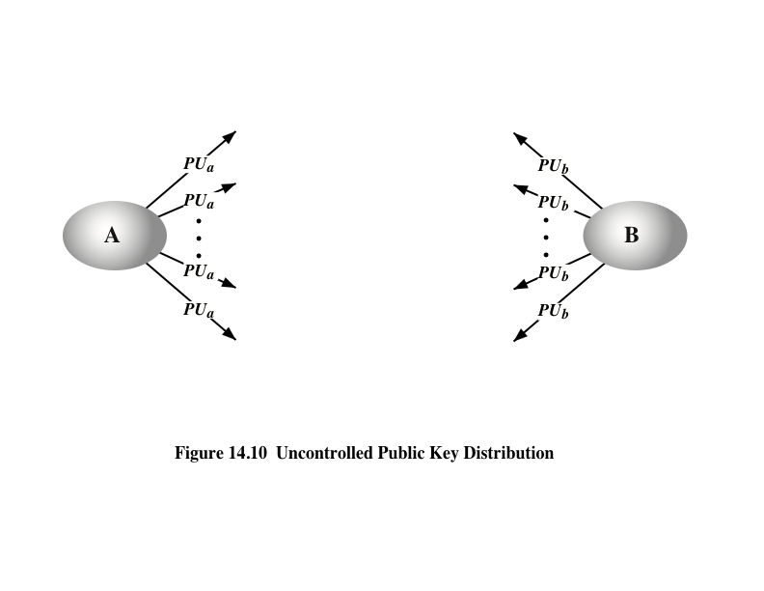
Notes:
On the face of it, the point of public-key encryption is that the public key is public.
Thus, if there is some broadly accepted public-key algorithm, such as RSA, any participant
can send his or her public key to any other participant or broadcast the key to the
community at large (Figure 14.10). For example, because of the growing popularity of
PGP (pretty good privacy, discussed in Chapter 19), which makes use of RSA, many
PGP users have adopted the practice of appending their public key to messages that
they send to public forums, such as USENET newsgroups and Internet mailing lists.
Although this approach is convenient, it has a major weakness. Anyone can
forge such a public announcement. That is, some user could pretend to be user A
and send a public key to another participant or broadcast such a public key. Until
such time as user A discovers the forgery and alerts other participants, the forger is
able to read all encrypted messages intended for A and can use the forged keys for
authentication (see Figure 9.3).

Slide 34
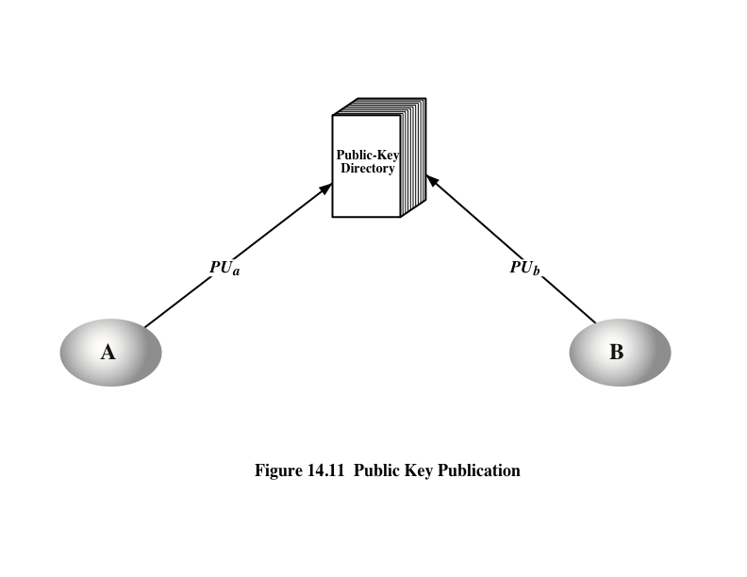
Notes:
A greater degree of security can be achieved by maintaining a publicly available
dynamic directory of public keys. Maintenance and distribution of the public
directory would have to be the responsibility of some trusted entity or organization
(Figure 14.11). Such a scheme would include the following elements:
1. The authority maintains a directory with a {name, public key} entry for each
participant.
2. Each participant registers a public key with the directory authority.
Registration would have to be in person or by some form of secure authenticated
communication.
3. A participant may replace the existing key with a new one at any time, either
because of the desire to replace a public key that has already been used for a
large amount of data, or because the corresponding private key has been compromised
in some way.
4. Participants could also access the directory electronically. For this purpose,
secure, authenticated communication from the authority to the participant is
mandatory.
This scheme is clearly more secure than individual public announcements
but still has vulnerabilities. If an adversary succeeds in obtaining or computing the
private key of the directory authority, the adversary could authoritatively pass out
counterfeit public keys and subsequently impersonate any participant and eavesdrop
on messages sent to any participant. Another way to achieve the same end is
for the adversary to tamper with the records kept by the authority.

Slide 35
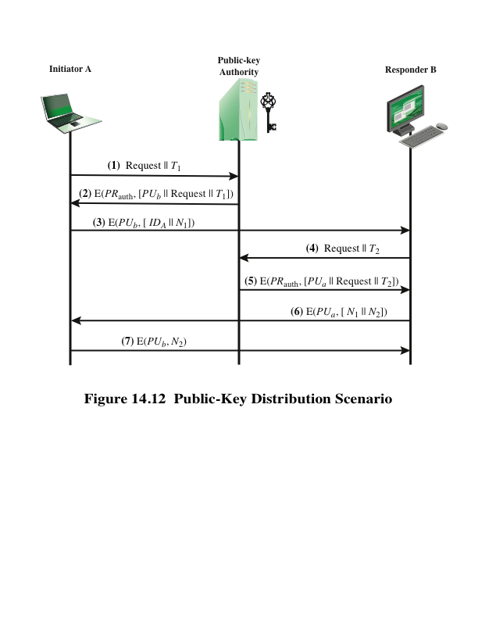
Notes:
Stronger security for public-key distribution can be achieved by providing
tighter control over the distribution of public keys from the directory. A typical
scenario is illustrated in Figure 14.12, which is based on a figure in [POPE79].
As before, the scenario assumes that a central authority maintains a dynamic
directory of public keys of all participants. In addition, each participant reliably
knows a public key for the authority, with only the authority knowing the corresponding
private key.
A total of seven messages are required. However, the initial five messages
need be used only infrequently because both A and B can save the other’s
public key for future use—a technique known as caching. Periodically, a user should
request fresh copies of the public keys of its correspondents to ensure currency.

Slide 36
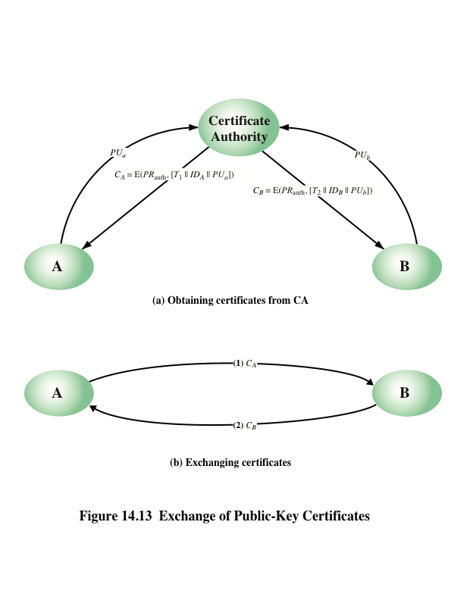
Notes:
The scenario of Figure 14.12 is attractive, yet it has some drawbacks. The public-key
authority could be somewhat of a bottleneck in the system, for a user must appeal
to the authority for a public key for every other user that it wishes to contact. As
before, the directory of names and public keys maintained by the authority is vulnerable
to tampering.
An alternative approach, first suggested by Kohnfelder [KOHN78], is to use
certificates that can be used by participants to exchange keys without contacting a
public-key authority, in a way that is as reliable as if the keys were obtained directly
from a public-key authority. In essence, a certificate consists of a public key, an
identifier of the key owner, and the whole block signed by a trusted third party.
Typically, the third party is a certificate authority, such as a government agency or a
financial institution, that is trusted by the user community. A user can present his or
her public key to the authority in a secure manner and obtain a certificate. The user
can then publish the certificate. Anyone needing this user’s public key can obtain
the certificate and verify that it is valid by way of the attached trusted signature.
A participant can also convey its key information to another by transmitting its
certificate. Other participants can verify that the certificate was created by the
authority. We can place the following requirements on this scheme:
1. Any participant can read a certificate to determine the name and public key of
the certificate’s owner.
2. Any participant can verify that the certificate originated from the certificate
authority and is not counterfeit.
3. Only the certificate authority can create and update certificates.
These requirements are satisfied by the original proposal in [KOHN78]. Denning
[DENN83] added the following additional requirement:
4. Any participant can verify the currency of the certificate.
A certificate scheme is illustrated in Figure 14.13. Each participant applies
to the certificate authority, supplying a public key and requesting a certificate.
Application must be in person or by some form of secure authenticated communication.

Slide 37
X.509 Certificates
Part of the X.500 series of recommendations that define a directory service
The directory is, in effect, a server or distributed set of servers that maintains a database of information about users
X.509 defines a framework for the provision of authentication services by the X.500 directory to its users
Was initially issued in 1988 with the latest revision in 2012
Based on the use of public-key cryptography and digital signatures
Does not dictate the use of a specific algorithm but recommends RSA
Does not dictate a specific hash algorithm
Each certificate contains the public key of a user and is signed with the private key of a trusted certification authority
X.509 defines alternative authentication protocols based on the use of public-key certificates
Notes:
ITU-T recommendation X.509 is part of the X.500 series of recommendations that
define a directory service. The directory is, in effect, a server or distributed set
of servers that maintains a database of information about users. The information
Includes a mapping from user name to network address, as well as other attributes
and information about the users.
X.509 defines a framework for the provision of authentication services by the
X.500 directory to its users. The directory may serve as a repository of public-key
certificates of the type discussed in Section 14.3. Each certificate contains the public
key of a user and is signed with the private key of a trusted certification authority.
In addition, X.509 defines alternative authentication protocols based on the use of
public-key certificates.
X.509 is an important standard because the certificate structure and authentication
protocols defined in X.509 are used in a variety of contexts. For example, the
X.509 certificate format is used in S/MIME (Chapter 19), IP Security (Chapter 20),
and SSL/TLS (Chapter 17).
X.509 was initially issued in 1988. The standard was subsequently revised
in 1993 to address some of the security concerns documented in [IANS90] and
[MITC90]. The standard is currently at version 7, issued in 2012.

Slide 38
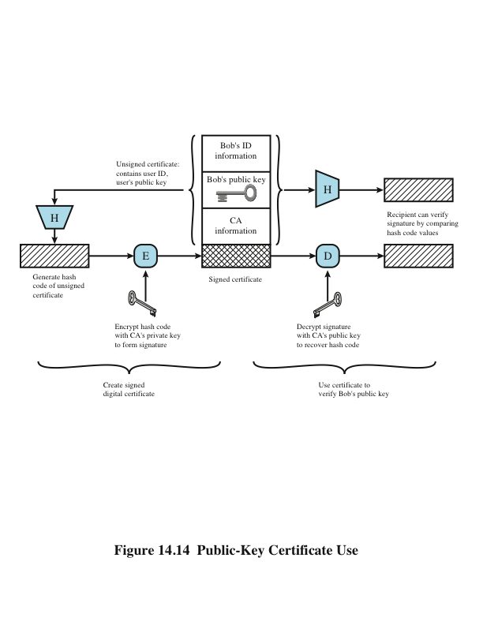
Notes:
X.509 is based on the use of public-key cryptography and digital signatures.
The standard does not dictate the use of a specific digital signature algorithm nor a
specific hash function. Figure 14.14 illustrates the overall X.509 scheme for generation
of a public-key certificate. The certificate for Bob’s public key includes unique
identifying information for Bob, Bob’s public key, and identifying information
about the CA, plus other information as explained subsequently. This information
is then signed by computing a hash value of the information and generating a digital
signature using the hash value and the CA’s private key. X.509 indicates that the
signature is formed by encrypting the hash value. This suggests the use of one of the
RSA schemes discussed in Section 13.6. However, the current version of X.509 does
not dictate a specific digital signature algorithm. If the NIST DSA (Section 13.4) or
the ECDSA (Section 13.5) scheme is used, then the hash value is not encrypted but
serves as input to a digital signature generation algorithm.

Slide 39
Certificates
Version
Serial number
Signature algorithm identifier
Issuer name
Period of validity
Subject name
Subject’s public-key information
Issuer unique identifier
Subject unique identifier
Extensions
Signature
Created by a trusted Certification Authority (CA) and have the following elements:
Notes:
The heart of the X.509 scheme is the public-key certificate associated with each
user. These user certificates are assumed to be created by some trusted certification
authority (CA) and placed in the directory by the CA or by the user. The directory
server itself is not responsible for the creation of public keys or for the certification
function; it merely provides an easily accessible location for users to obtain
certificates.
• Version: Differentiates among successive versions of the certificate format;
the default is version 1. If the issuer unique identifier or subject unique identifier
are present, the value must be version 2. If one or more extensions are
present, the version must be version 3.
• Serial number: An integer value unique within the issuing CA that is unambiguously
associated with this certificate.
• Signature algorithm identifier: The algorithm used to sign the certificate
Together
with any associated parameters. Because this information is repeated
in the signature field at the end of the certificate, this field has little, if any,
utility.
• Issuer name: X.500 name of the CA that created and signed this certificate.
• Period of validity: Consists of two dates: the first and last on which the certificate
is valid.
• Subject name: The name of the user to whom this certificate refers. That is,
this certificate certifies the public key of the subject who holds the corresponding
private key.
• Subject’s public-key information: The public key of the subject, plus an identifier
of the algorithm for which this key is to be used, together with any associated
parameters.
• Issuer unique identifier: An optional-bit string field used to identify uniquely
the issuing CA in the event the X.500 name has been reused for different
entities.
• Subject unique identifier: An optional-bit string field used to identify uniquely
the subject in the event the X.500 name has been reused for different entities.
• Extensions: A set of one or more extension fields. Extensions were added in
version 3 and are discussed later in this section.
• Signature: Covers all of the other fields of the certificate; it contains the
hash code of the other fields encrypted with the CA’s private key. This field
includes the signature algorithm identifier.
The unique identifier fields were added in version 2 to handle the possible
reuse of subject and/or issuer names over time. These fields are rarely used.

Slide 40
Obtaining a Certificate
Because certificates are unforgeable, they can be placed in a directory without the need for the directory to make special efforts to protect them
In addition, a user can transmit his or her certificate directly to other users
Once B is in possession of A’s certificate, B has confidence that messages it encrypts with A’s public key will be secure from eavesdropping and that messages signed with A’s private key are unforgeable
User certificates generated by a CA have the following characteristics:
Any user with access to the public key of the CA can verify the user public key that was certified
No party other than the certification authority can modify the certificate without this being detected
Notes:
User certificates generated by a CA have the following
characteristics:
• Any user with access to the public key of the CA can verify the user public key
that was certified.
• No party other than the certification authority can modify the certificate without
this being detected.
Because certificates are unforgeable, they can be placed in a directory without the
need for the directory to make special efforts to protect them.
If all users subscribe to the same CA, then there is a common trust of that CA.
All user certificates can be placed in the directory for access by all users. In addition,
a user can transmit his or her certificate directly to other users. In either case,
once B is in possession of A’s certificate, B has confidence that messages it encrypts
with A’s public key will be secure from eavesdropping and that messages signed
with A’s private key are unforgeable.
If there is a large community of users, it may not be practical for all users to
subscribe to the same CA. Because it is the CA that signs certificates, each participating
user must have a copy of the CA’s own public key to verify signatures. This
public key must be provided to each user in an absolutely secure (with respect to
integrity and authenticity) way so that the user has confidence in the associated certificates.
Thus, with many users, it may be more practical for there to be a number
of CAs, each of which securely provides its public key to some fraction of the users.

Slide 41
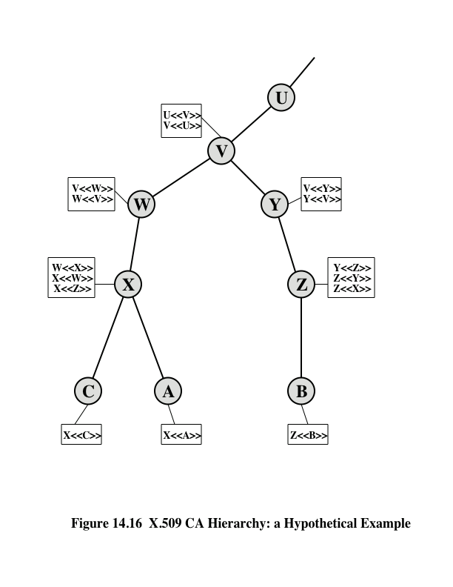
Notes:
Figure 14.16 illustrates the use of an X.509 hierarchy to mutually verify clients certificates.
The connected
circles indicate the hierarchical relationship among the CAs; the associated
boxes indicate certificates maintained in the directory for each CA entry. The directory
entry for each CA includes two types of certificates:
• Forward certificates: Certificates of X generated by other CAs
• Reverse certificates: Certificates generated by X that are the certificates of
other CAs

Slide 42
Certificate Revocation
Each certificate includes a period of validity
Typically a new certificate is issued just before the expiration of the old one
It may be desirable on occasion to revoke a certificate before it expires, for one of the following reasons:
The user’s private key is assumed to be compromised
The user is no longer certified by this CA
The CA’s certificate is assumed to be compromised
Each CA must maintain a list consisting of all revoked but not expired certificates issued by that CA
These lists should be posted on the directory
Notes:
Recall from Figure 14.15 that each certificate
includes a period of validity, much like a credit card. Typically, a new certificate
is issued just before the expiration of the old one. In addition, it may be desirable
on occasion to revoke a certificate before it expires, for one of the following
reasons.
1. The user’s private key is assumed to be compromised.
2. The user is no longer certified by this CA. Reasons for this include that the
subject’s name has changed, the certificate is superseded, or the certificate was
not issued in conformance with the CA’s policies.
3. The CA’s certificate is assumed to be compromised.
Each CA must maintain a list consisting of all revoked but not expired certificates
issued by that CA, including both those issued to users and to other CAs.
These lists should also be posted on the directory.
Each certificate revocation list (CRL) posted to the directory is signed by the
issuer and includes (Figure 14.15b) the issuer’s name, the date the list was created,
the date the next CRL is scheduled to be issued, and an entry for each revoked
certificate. Each entry consists of the serial number of a certificate and revocation
date for that certificate. Because serial numbers are unique within a CA, the serial
number is sufficient to identify the certificate.
When a user receives a certificate in a message, the user must determine
whether the certificate has been revoked. The user could check the directory each
time a certificate is received. To avoid the delays (and possible costs) associated
with directory searches, it is likely that the user would maintain a local cache of certificates
and lists of revoked certificates.

Slide 43
Key and Policy Information
These extensions convey additional information about the subject and issuer keys plus indicators of certificate policy
A certificate policy is a named set of rules that indicates the applicability of a certificate to a particular community and/or class of application with common security requirements
Included are:
Authority key identifier
Subject key identifier
Key usage
Private-key usage period
Certificate policies
Policy mappings
Notes:
These extensions convey additional information
about the subject and issuer keys, plus indicators of certificate policy. A certificate
policy is a named set of rules that indicates the applicability of a certificate to a particular
community and/or class of application with common security requirements.
For example, a policy might be applicable to the authentication of electronic data
interchange (EDI) transactions for the trading of goods within a given price range.
This area includes:
• Authority key identifier: Identifies the public key to be used to verify the signature
on this certificate or CRL. Enables distinct keys of the same CA to be
differentiated. One use of this field is to handle CA key pair updating.
• Subject key identifier: Identifies the public key being certified. Useful for subject
key pair updating. Also, a subject may have multiple key pairs and, correspondingly,
different certificates for different purposes (e.g., digital signature
and encryption key agreement).
• Key usage: Indicates a restriction imposed as to the purposes for which, and
the policies under which, the certified public key may be used. May indicate
one or more of the following: digital signature, nonrepudiation, key encryption,
data encryption, key agreement, CA signature verification on certificates,
CA signature verification on CRLs.
• Private-key usage period: Indicates the period of use of the private key corresponding
to the public key. Typically, the private key is used over a different
period from the validity of the public key. For example, with digital signature
keys, the usage period for the signing private key is typically shorter than that
for the verifying public key.
• Certificate policies: Certificates may be used in environments where multiple
policies apply. This extension lists policies that the certificate is recognized as
supporting, together with optional qualifier information.
• Policy mappings: Used only in certificates for CAs issued by other CAs. Policy
mappings allow an issuing CA to indicate that one or more of that issuer’s
policies can be considered equivalent to another policy used in the subject
CA’s domain.

Slide 44

Certificate Subject and Issuer Attributes
These extensions support alternative names, in alternative formats, for a certificate subject or certificate issuer
Can convey additional information about the certificate subject to increase a certificate user’s confidence that the certificate subject is a particular person or entity
The extension fields in this area include:
Subject alternative name
Issuer alternative name
Subject directory attributes
Notes:
These extensions support alternative
names, in alternative formats, for a certificate subject or certificate issuer and can
convey additional information about the certificate subject to increase a certificate
user’s confidence that the certificate subject is a particular person or entity. For
example, information such as postal address, position within a corporation, or picture
image may be required.
The extension fields in this area include:
• Subject alternative name: Contains one or more alternative names, using any of a
variety of forms. This field is important for supporting certain applications, such
as electronic mail, EDI, and IPSec, which may employ their own name forms.
• Issuer alternative name: Contains one or more alternative names, using any of
a variety of forms.
• Subject directory attributes: Conveys any desired X.500 directory attribute
values for the subject of this certificate.

Slide 45
Certification Path Constraints
These extensions allow constraint specifications to be included in certificates issued for CAs by other CAs
The constraints may restrict the types of certificates that can be issued by the subject CA or that may occur subsequently in a certification chain
The extension fields in this area include:
Basic constraints
Name constraints
Policy constraints
Notes:
These extensions allow constraint specifications
to be included in certificates issued for CAs by other CAs. The constraints may
restrict the types of certificates that can be issued by the subject CA or that may
occur subsequently in a certification chain.
The extension fields in this area include:
• Basic constraints: Indicates if the subject may act as a CA. If so, a certification
path length constraint may be specified.
• Name constraints: Indicates a name space within which all subject names in
subsequent certificates in a certification path must be located.
• Policy constraints: Specifies constraints that may require explicit certificate
policy identification or inhibit policy mapping for the remainder of the certification
path.

Slide 46
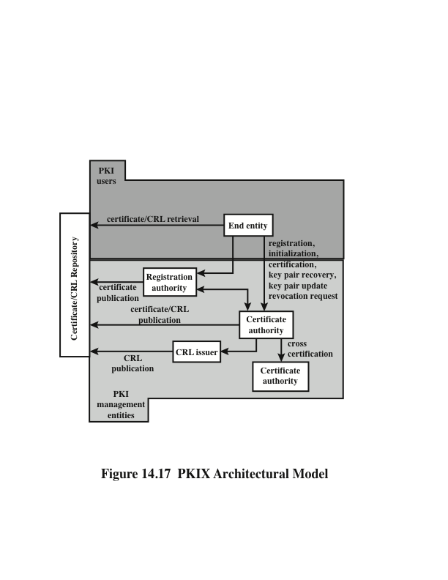
Notes:
RFC 4949 (Internet Security Glossary ) defines public-key infrastructure (PKI) as
the set of hardware, software, people, policies, and procedures needed to create,
manage, store, distribute, and revoke digital certificates based on asymmetric cryptography.
The principal objective for developing a PKI is to enable secure, convenient,
and efficient acquisition of public keys. The Internet Engineering Task Force
(IETF) Public Key Infrastructure X.509 (PKIX) working group has been the driving
force behind setting up a formal (and generic) model based on X.509 that is
suitable for deploying a certificate-based architecture on the Internet. This section
describes the PKIX model.
Figure 14.17 shows the interrelationship among the key elements of the PKIX
model. These elements are
• End entity: A generic term used to denote end users, devices (e.g., servers,
routers), or any other entity that can be identified in the subject field of a
public-key certificate. End entities typically consume and/or support
PKI-related services.
• Certification authority (CA): The issuer of certificates and (usually) certificate
revocation lists (CRLs). It may also support a variety of administrative
functions, although these are often delegated to one or more Registration
Authorities.
• Registration authority (RA): An optional component that can assume a
number of administrative functions from the CA. The RA is often associated
with the end entity registration process but can assist in a number of other
areas as well.
• CRL issuer: An optional component that a CA can delegate to publish CRLs.
• Repository: A generic term used to denote any method for storing certificates
and CRLs so that they can be retrieved by end entities.

Slide 47
PKIX Management Functions
PKIX identifies a number of management functions that potentially need to be supported by management protocols:
Registration
Initialization
Certification
Key pair recovery
Key pair update
Revocation request
Cross certification
Notes:
PKIX identifies a number of management functions that potentially need to be supported
by management protocols. These are indicated in Figure 14.17 and include
the following:
• Registration: This is the process whereby a user first makes itself known to
a CA (directly or through an RA), prior to that CA issuing a certificate or
certificates for that user. Registration begins the process of enrolling in a PKI.
Registration usually involves some offline or online procedure for mutual
authentication. Typically, the end entity is issued one or more shared secret
keys used for subsequent authentication.
• Initialization: Before a client system can operate securely, it is necessary to
install key materials that have the appropriate relationship with keys stored
elsewhere in the infrastructure. For example, the client needs to be securely
initialized with the public key and other assured information of the trusted
CA(s), to be used in validating certificate paths.
• Certification: This is the process in which a CA issues a certificate for a user’s
public key, returns that certificate to the user’s client system, and/or posts that
certificate in a repository.
• Key pair recovery: Key pairs can be used to support digital signature creation
and verification, encryption and decryption, or both. When a key pair is used
for encryption/decryption, it is important to provide a mechanism to recover
the necessary decryption keys when normal access to the keying material is
no longer possible, otherwise it will not be possible to recover the encrypted
data. Loss of access to the decryption key can result from forgotten passwords/
PINs, corrupted disk drives, damage to hardware tokens, and so on. Key pair
recovery allows end entities to restore their encryption/decryption key pair
from an authorized key backup facility (typically, the CA that issued the end
entity’s certificate).
• Key pair update: All key pairs need to be updated regularly (i.e., replaced
with a new key pair) and new certificates issued. Update is required when the
certificate lifetime expires and as a result of certificate revocation.
• Revocation request: An authorized person advises a CA of an abnormal situation
requiring certificate revocation. Reasons for revocation include private-key
compromise, change in affiliation, and name change.
• Cross certification: Two CAs exchange information used in establishing a
cross-certificate. A cross-certificate is a certificate issued by one CA to another
CA that contains a CA signature key used for issuing certificates.

Slide 48
Summary
Symmetric key distribution using symmetric encryption
Key distribution scenario
Hierarchical key control
Session key lifetime
Transparent key control scheme
Decentralized key control
Controlling key usage
Symmetric key distribution using asymmetric encryption
Simple secret key distribution
Secret key distribution with confidentiality and authentication
Hybrid scheme
Key Generation
True random number generation and testing
Distribution of public keys
Public announcement of public keys
Publicly available directory
Public-key authority
Public-key certificates
Public-key infrastructure
PKIX management functions
PKIX management protocols
Notes:
Chapter 14 summary.

